Slide 1
INTEGRATED TEEN COURT IN LOS ANGELES COUNTY:
UTILIZING RESPONSIBLE RESTORATIVE JUSTICE TO ADDRESS MENTAL HEALTH ISSUES FOR TRANSITIONAL AGE YOUTH.

Slide 2
PRESENTERS
Seymour I. Amster, J.D. – Parents, Educators/Teachers & Students in Action
Judge Denise McLaughlin-Bennett, JD – Los Angeles Superior Court Judge
Michele Archambeault, PsyD – Los Angeles County Department of Mental Health
Kay Duncan – Los Angeles County Department of Probation

Slide 3
THE LAW ON MINORS COMMITING CRIMES WAS AMENDED THIS YEAR
Section 602.1 of the Welfare and Institutions Code is amended to read:
(a) In order to ensure the safety and well-being of minors who are under 12 years of age and whose behavior would otherwise bring them within the jurisdiction of the juvenile court pursuant to Section 601 or 602, it is the intent of the Legislature that counties pursue appropriate measures to serve and protect a child only as needed, avoiding any intervention whenever possible, and using the least restrictive alternatives through available school-, health-, and community-based services. It is the intent of the Legislature that counties use existing funding for behavioral health, mental health, or other available existing funding sources to provide the alternative services required by this section.
(b) Except as provided in subdivision (b) of Section 602, when a minor under 12 years of age comes to the attention of law enforcement because his or her behavior or actions are as described in Section 601 or 602, the response of the county shall be to release the minor to his or her parent, guardian, or caregiver. Counties shall develop a process for determining the least restrictive responses that may be used instead of, or in addition to, the release of the minor to his or her parent, guardian, or caregiver.
(c) This section shall become operative on January 1, 2020.

Slide 4
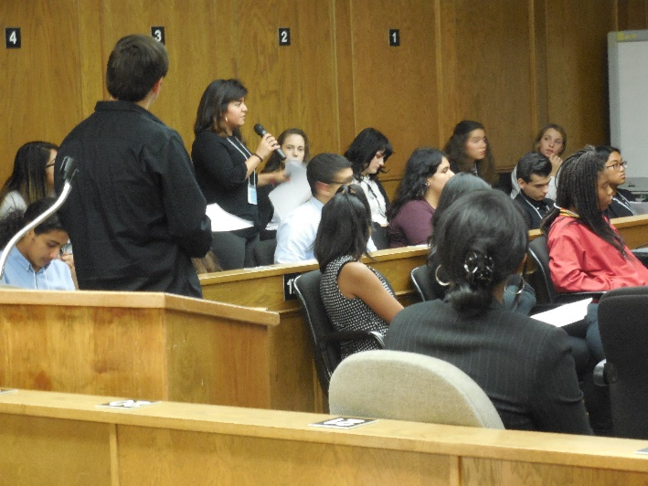
Teen Court Program
The Teen Court program is a juvenile diversionary program for youthful offenders who commit non-violent offenses.
Over 42 high schools with more than 60,000 students in Los Angeles County participate in the Teen Court Program, and over 82 Superior Court judges volunteer their time to the program.
The youth who has been diverted to the program is placed on trial with participating high school student jurors asking the youth as well as his [or her] parents critical questions.
From this information received at trial, the jurors, after receiving instructions on the law from the judge, determine the culpability of the youth and recommend diversionary conditions that contain restorative justice concepts.
The judicial officer then imposes [some or all of the recommended] diversionary conditions and places the minor on probation for a period of six months.
If the youth complies with the terms of the diversionary conditions then he or she is deemed to have successfully completed the program and the youth avoids having a criminal record.

Slide 5
Traditional Route – Juvenile Court
Feel like criminal – interact with other criminals – Less individual attention
Great Risk of reoffending

Slide 6
Teen Court – Diversion Program
Reevaluate Conduct – Interact with peers – More individualized attention – Restorative Justice
Less chance of reoffending

Slide 7
THE TEEN COURT PROGRAM IN THE ANTELOPE VALLEY IS A COLLOBORATION BETWEEN:
Los Angeles County Probation Department
Los Angeles County Superior Court
Los Angeles County Department of Mental Health
Parents, Educators/Teachers & Students in Action

Slide 8
ROLE OF LOS ANGELES COUNTY PROBATION DEPARTMENT
Selecting appropriate cases.
Meeting with minor and parent.
Participating in the Teen Court Session
Monitoring the diverted minor.

Slide 9
ROLE OF LOS ANGELES COUNTY DEPARTMENT OF MENTAL HEALTH
Reviewing case files.
Meeting with minor and parent.
Addressing needs for all inclusive care program.
Participating in the Teen Court Session
Making Recommendations for conditions of diversion.

Slide 10
ROLE OF LOS ANGELES COUNTY
SUPERIOR COURT
Preparing for the Teen Court session.
Presiding over the Teen Court session.
Description of the Teen Court session.
Description of all of the participants in the Teen Court session.
Discussions with audience during deliberations.

Slide 11
ROLE OF PARENTS, EDUCATORS/TEACHERS & STUDENTS IN ACTION (PESA)
CBO of the Teen Court Program
Provide support to the Teen Court Program.
Conduct Student, Educator and Parent workshops.
Ensure participation in CAYC and SHADES

Slide 12
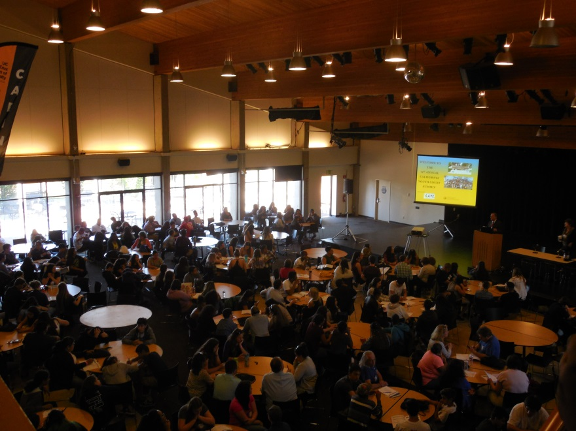
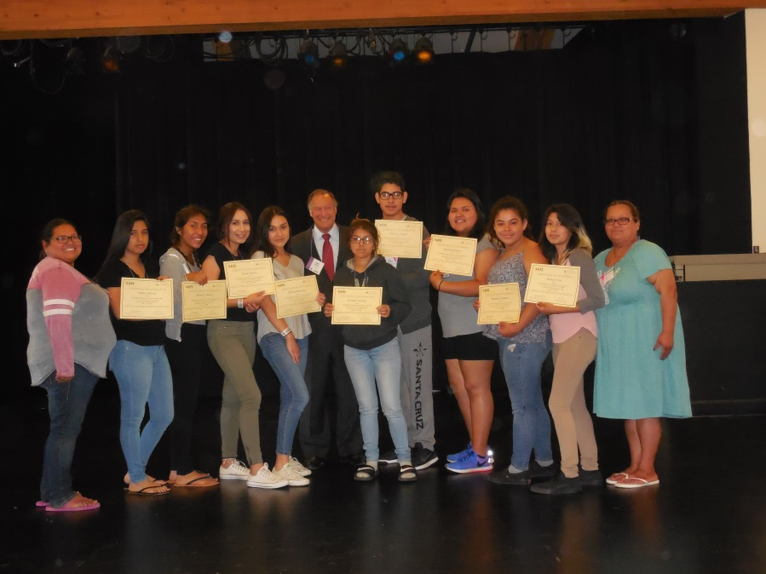
CAYC
The California Association of Youth Courts was created for the purpose of facilitating the exchange of information between emerging and existing California Youth Courts.
The CAYC Summit is an annual event held every summer where students and educators from all over the state of California attend seminars, have group discussions with Superior Court Judges and other professionals in order to learn best practices that they can apply to their own Teen Court program.

Slide 13
SHADES
SHADES
SHADES is an acronym for Stopping Hate and Delinquency by Empowering Students (SHADES)
Students involved in the program receive a week-long tolerance training at the Museum of Tolerance that assists them in developing an understanding of issues related to diversity and problems created by prejudice, hate, and bullying.
In order to participate in the SHADES program, a student must first be a participant in the Teen Court program.
Minors committing hate incidents are referred to the Teen Court Program to be tried by a SHADES trained jury and if found culpable are placed on informal probation to be mentored by a Superior Court Judge.
Then those participating in SHADES engage in community outreach to educate others on what they have learned.

Slide 14
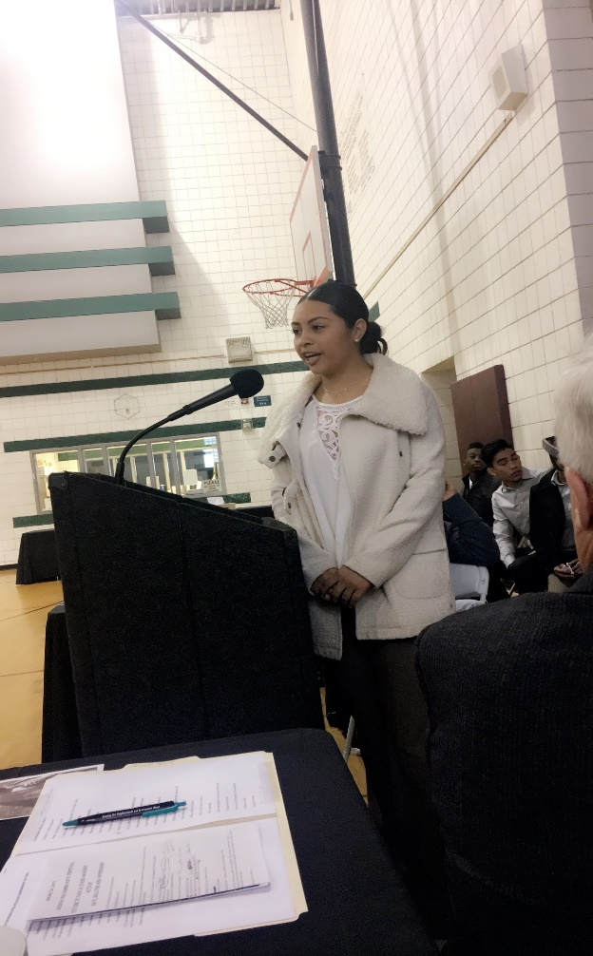
COMMUNITY OUTREACH PROGRAMS
SHADES trained participants educate the community by illuminating our residents about the value of accepting and interacting with a diversified community by:
Presentations at schools.
Presentations at Community Festivals.
Presentations to Community groups.
At all these activities they distribute a handout that emphasizes what they have taught.

Slide 15
HANDOUT

Slide 16
ONLY PROACTIVE DIVERSION PROGRAM IN THE COUNTY OF LOS ANGELES
Through education, Teen Court is teaching the youth in our community how to avoid negative contact with law enforcement.
The Teen Court Program is one of the most successful diversion programs in the country, with a success rate of over 90%.
Teen Court is reducing crime in our community before it occurs and providing the tools for our youth to lead a successful productive life.

Slide 17
QUESTIONS ? Together we can continue to make a difference in the lives of our children. Seymour I. Amster, Executive Director Cell Phone: 818-943-0613 Main Line: 800-894-7201 extension 102, Email: SeymourAmster.Pesa@gmail.com PESA is a 501 (c) (3) non-profit Parents, Educators/Teachers & Students in Action 18017 Chatsworth Street, Suite 337 , Granada Hills, Ca. 91344 800-894-7201

